Slide 1
Applied HCI COMP719
Week 7
Perception / Cognition Review
And Learning

Slide 2
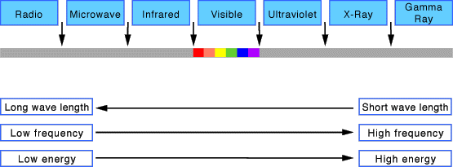
Vision
Vision begins with light
The nature of light
http://science.howstuffworks.com/light2.htm

Slide 3
Vision
There are two stages in vision:
• physical reception of stimulus (the eye)
• processing and interpretation of stimulus (the brain)

Slide 4
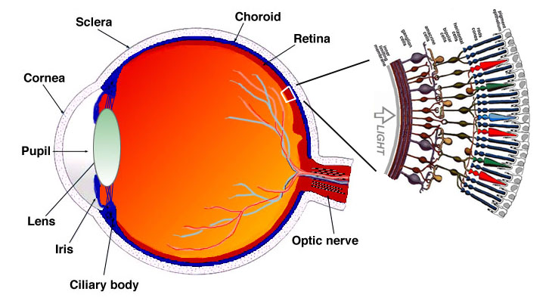
The Human eye
fovea
Blind spot
http://webvision.med.utah.edu/imageswv/Sagschem.jpeg

Slide 5
The Human eye
An optical system for receiving light and transforming it into electrical energy
Light reflects from objects
Images are focused upside-down on retina
Retina contains rods and cones
Rods are highly sensitive to light – low light vision
Cones - for colour vision
Ganglion cells detect pattern and movement
The optic nerve contains the ganglion cell axons running to the brain

Slide 6
Interpreting the signal
Perceiving size and depth
Perceiving brightness
Perceiving colour

Slide 7
Interpreting the signal
Perceiving size and depth
visual angle indicates how much of view object occupies (relates to size and distance from eye)
visual acuity is ability to perceive detail (limited)
familiar objects are perceived as constant size (in spite of changes in visual angle when far away)
cues like overlapping help perception of size and depth

Slide 8

Interpreting the signal
Visual angle – objects of different sizes and different distances may have the same visual angle:
Objects of the same size at different distances have different visual angles:

Slide 9
Interpreting the signal
Perceiving brightness – subjective reaction to levels of light
Affected by luminance (amount of light emitted by an object)
Contrast – function of the luminance of an object and that of its background
Increased brightness increases visual acuity, i.e. helps see more detail
Increased luminance increases flicker (more noticeable in peripheral vision – large displays)

Slide 10
Interpreting the signal
Perceiving colour
Colour is made up of hue (wavelength), intensity (colour brightness), saturation (amount of whiteness)
cones sensitive to colour wavelengths
blue acuity is lowest
8% males and 1% females are colour blind (have colour vision deficiency)

Slide 11
Interpreting the signal
Perceiving colour:
White, Black , Gray are not positioned on the electromagnetic spectrum. This is because they are special cases.
White, Black , Gray do not have any hue and are known as achromatic colours
Red, Green, Blue can all be measured in terms of hue as each of these colours exists in a pure single wave length of colour.
All other colours are a mixture of wave lengths.
Depending on luminance Gray is an easy colour to stare at for long periods of time. Microsoft use equal amounts of RGB at 191 for the Windows interface.

Slide 12
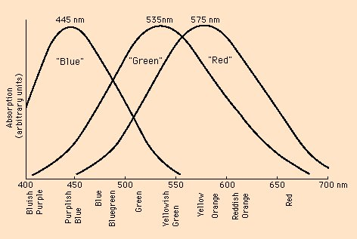
The "green" and "red" cones are mostly packed into the fovea.
About 64% of the cones are red-sensitive, about 32% green sensitive, and about 2% are blue sensitive.
The "blue" cones have the highest sensitivity and are mostly found outside the fovea. http://hyperphysics.phy-astr.gsu.edu/hbase/vision/colcon.html#c1
Response curves for three different kind of cones in the retina of the human eye.

Slide 13
Capabilities and limitations of visual processing
The visual system compensates for:
Movement (image moves on the retina when we move)
Changes in luminance (colour and brightness are perceived as constant)
Context is used to resolve ambiguity
Different areas in the visual field (the range of degrees discernible to the human) have different sensitiveness to colour and movement
Optical illusions sometimes occur due to over-compensation

Slide 14
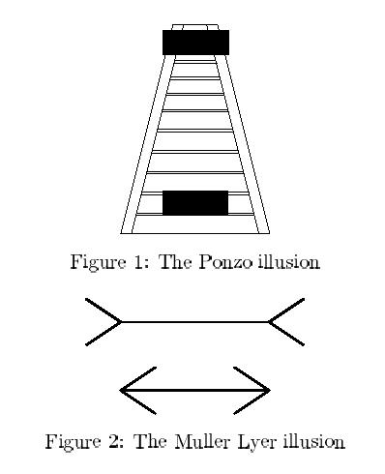
Our perception of size is not completely reliable

Slide 15
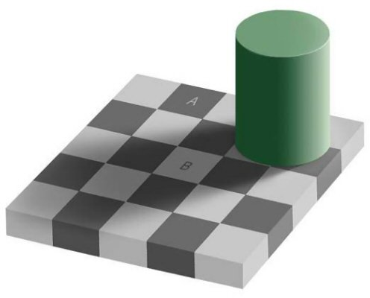

Slide 16
Use of colour
Red text appears to lie in one depth plane
Blue text appears to lie in a different plane
Red text appears to lie in one depth plane
Blue text appears to lie in a different plane
Red text appears to lie in one depth plane
Blue text appears to lie in a different plane
Red text appears to lie in one depth plane
Blue text appears to lie in a different plane

Slide 17
Use of colour
Red text appears to lie in one depth plane
Blue text appears to lie in a different plane
Red text appears to lie in one depth plane
Blue text appears to lie in a different plane
Red text appears to lie in one depth plane
Blue text appears to lie in a different plane
Red text appears to lie in one depth plane
Blue text appears to lie in a different plane

Slide 18
Stroop effect (described by J.R. Stroop in 1935)
green
black
blue
red
yellow
pink
green
black
blue
red
yellow
pink
green
black
blue
red
yellow
pink
зелен
черен
син
червен
жълт
розов

Slide 19
Stroop effect
Stroop effect recognises that once people have learned to read they have a tendency to read whatever is put in front of them.
When faced with two contradictory sources of information (in this case colour written in the wrong colour) there is a conflict
If the text on the sign contradicts the conventional meaning of the colour there is conflict too.
STOP
STOP
Notes:
Dayl’s example: if you see a green road sign with STOP written on it, the natural impulse would be to go but the word “stop” would make you want to stop.

Slide 20
Reading
Several stages:
visual pattern perceived
decoded using internal representation of language
interpreted using knowledge of syntax, semantics, pragmatics
Reading involves saccades and fixations
Perception occurs during fixations (94% of time)
Word shape is important to recognition

Slide 21
Reading
Several stages:
visual pattern perceived
decoded using internal representation of language
interpreted using knowledge of syntax, semantics, pragmatics
Reading involves saccades and fixations
Perception occurs during fixations (94% of time)
Word shape is important to recognition
Negative contrast, in theory, improves reading from a screen
Positive contrast makes reading from computer screen harder
(perhaps more tiring ???)

Slide 22
Hearing
Hearing begins with vibrations in the ear (sound waves)
Sound is the change in air pressure
Hearing is the second most important sense after sight.

Slide 23
Sound
Sound properties:
Pitch
Loudness
Timbre
Sound is used as a locator (2 ears)
Permanent hearing impairment – about 10% of population

Slide 24
Sound
Pitch is the sensation of sound frequency
1 Hertz = 1 vibration/second
20 Hz 20 000 Hz
The ear is insensitive to frequencies<20Hz
Most sensitive to range 1000-4000Hz (top two octaves of the piano)
infrasound
ultrasound

Slide 25
Sound
Loudness (related to intensity) is the perception of the amplitude of the sound wave
Source Intensity
TOH (threshold of hearing) 0 dB
Rustling Leaves 10 dB
Whisper 20 dB
Normal Conversation 60 dB
Busy Street Traffic 70 dB (start of danger zone)
Vacuum Cleaner 80 dB
Large Orchestra 98 dB (hearing loss with prolonged exposure)
MP3 player at Maximum Level 100 dB
Front Rows of Rock Concert 110 dB
Threshold of Pain 130 dB
Military Jet Takeoff 140 dB
Instant Perforation of Eardrum 160 dB

Slide 26
Sound
Timbre - type or quality of sound
Sounds may have the same pitch and loudness but be made by different instruments and so vary in timbre.
Musical sound used for navigation in the interface – earcon (vs icon?)

Slide 27
Advantages of Auditory over Visual
Using the auditory modality offers advantages in the following cases:
When the message is short.
When the message need not be referred to at a later date.
When the message deals with events in time
e.g. A story / narrative, or procedural instruction
When the message calls for immediate action, e.g. starter gun at a race.

Slide 28
Short-term memory
Some concepts related to STM:
chunking
closure
primacy effect
recency effect

Slide 29
Touch – the haptic channel
Stimulus received via receptors in the skin:
thermoreceptors - heat and cold
nociceptors – pain, intense pressure
mechanoreceptors - pressure (some instant, some continuous)
Some areas more sensitive than others e.g. fingers.
Proprioception (due to receptors in the joints) - awareness of body position affects comfort and performance.

Slide 30
Short-term memory
Chunking:
Means the grouping together of information in sections that make sense to the individual or are seen as entities by that individual. (e.g. passwords, phone numbers, menu in MS applications, etc.)
It provides a mechanism for building hierarchical structures – a way of decomposing a large representation into its smaller parts. It’s an efficient way to represent large amounts of information.

Slide 31
26831940759
617 3345 6277
64 3 587 2706

Slide 32
Short-term memory
Closure:
Successful formation of a chunk
Accounts for the desire to complete/close tasks held in STM
If closure does not occur there might be errors
It is important to build closure in systems

Slide 33
Short-term memory
Primacy effect:
In free recall exercises there is a tendency for the first one or two words to be remembered well
Recency effect:
Generally words at the end of a free recalled list are well remembered
If there is some interference with the recall process, the primacy effect will still operate but the recency effect would be destroyed.

Slide 34
Long-term memory
LTM is our memory for the past
LTM is the repository for all our knowledge:
slow access - 1/10 second
slow decay, if any
huge (or unlimited?) capacity
LTM is essentially 'knowledge in the head'
Notes:
The london cab test..(the knowledge) .. Cab drivers are ask a to memorized all details roadds, building…

Slide 35
LTM processes
Three main activities/processes are related to LTM:
Storage
Forgetting
Information retrieval

Slide 36
LTM processes: Storage
Storage (remembering, retention):
Information moves from STM to LTM by rehearsal (repetition, practice);
Total time hypothesis - amount of stored information is proportional to rehearsal time;
Distribution of practice effect - storage of information is optimised by spreading learning over time;
Structure, meaning and familiarity make information easier to remember;

Slide 37
boat tree cat child rug plate church gun flame head
faith age cold tenet quiet logic idea value past vast
Words representing concepts are more difficult to remember than words representing objects

Slide 38
LTM processes: Forgetting
Forgetting - 2 theories:
Decay - information is lost gradually but very slowly;
Interference -
retroactive interference - new information replaces (masks?) old;
proactive inhibition - old may interfere with new;

Slide 39
LTM processes: Retreival
Information retrieval:
recall - information reproduced from memory (e.g. passwords);
recognition - information is cue; less complex than recall; forces stimuli into STM first.
Our mind tends to fill in missing information or even invent it.
Memory is selective and is affected by emotion, stress, tiredness.

Slide 40
Thinking: reasoning and problem solving
Reasoning is a means of inferring new information from what is already known.
Types of reasoning:
Deductive
Inductive
Abductive

Slide 41
Types of reasoning
Deductive: derive logically necessary conclusions from given premises:
The most famous example:
Socrates is a man.
All men are mortal.
Therefore, Socrates is mortal.

Slide 42
Types of reasoning
Deductive: derive logically necessary conclusions from given premises:
If it is Friday then she will go to work
It is Friday
Therefore she will go to work
Valid deduction and is true
A logical conclusion can be valid but not necessarily true:
If it is raining then the ground is dry
It is raining
Therefore the ground is dry.
Premises (things we know)
conclusion
Notes:
Nost famous

Slide 43
Types of reasoning
Deductive reasoning is easy to program;
We bring our knowledge about the world into the reasoning process;
We assume certain amount of shared knowledge about the world in our dealings with others (to interpret inferences).
Notes:
Most famous

Slide 44
Reasoning (cont.)
Inductive reasoning (probabilistic): generalise from cases we have seen to infer information about cases we have not seen
All elephants we have seen have trunks therefore all elephants have trunks.
Notes:
.

Slide 45
Reasoning (cont.)
Inductive reasoning can be seen as the opposite of deductive reasoning (moving from examples to theory)
It is a useful process allowing us to learn about our environment.
Harder to program than the deductive reasoning

Slide 46
Reasoning (cont.)
Abductive reasoning: reasoning from event (result) to cause (aka ‘reasoning to the best explanation’):
John drives fast when drunk.
If you see John driving fast assume he is drunk

Slide 47
Reasoning (cont.)
Abduction is inference to the best explanation and has applications to diagnosis, plan recognition, natural language understanding, vision, and many other tasks. It is frequently formalized as constructing a set of assumptions that logically imply and therefore 'explain' a set of observations.
Extreme example of abductive reasoning:
All cats die.
Socrates is dead.
Therefore, Socrates is a cat. (MLRG, n.d.)
Abductive reasoning is unreliable – can lead to false explanations
Easiest for humans, hardest for computers
In HCI – If an event always follows an action, user infers that the event is caused by the action

Slide 48
Learning
Active process
Involves acquiring knowledge
Procedural Knowledge
How you do something
Declarative Knowledge
Facts, rules etc.

Slide 49
Dreyfus 5 stages
Novice
Advanced Beginner
Competence
Proficiency
Expert

Slide 50
Learning
Move up scale, from novice to expert
May not need to go as far as expert
Transform explicit knowledge into implicit knowledge
Tell, show, do
See one, Do one, Teach one

Slide 51
Novice
Does what they are told to do.
Rule- based decision making
No insight into why, just what.
Driving a car: First lesson
Computing : Newbie

Slide 52
Advanced Beginner
More experience.
Starts to analyse examples
Still sees problems as caused by system not self “It didn’t work”
Driving a car: Usually changing gear correctly.
Computing: Can follow list, but gets upset by unexpected behaviour.

Slide 53
Competency
Much wider mental model.
Takes responsibility for the outcome.
More experience, and more understanding of that experience.
Driving a car: Can do all the maneuvers, but still need to think about them
Computing: Can do most tasks, and predict how to do new ones.

Slide 54
Proficiency
Much more experience.
Able to plan at much higher level
Still uses rules occasionally
Driving a car: Most actions automatic, can be overwhelmed.
Computing : Confident about package, and can transfer this knowledge to other packages. Concentrates on task.

Slide 55
Expert
Very experienced.
Perform procedures automatically
Can write new rules
Driving a Car: Professional driver/advanced level, very little attention focused on mechanics of driving
Computing: “Power user” – can read manual!

Slide 56
Learning and HCI
Lots of short lessons more effective than long ones – common experience with software.
How much learning can you expect the user to put in ?
Usually, only novices any use for usability testing.

Slide 57
Learning Styles
sensing learners or intuitive learners
visual learners or verbal learners
inductive learners or deductive learners
active learners or reflective learners
sequential learners or global learners

Slide 58
Learnability
Learning Overhead vs expected returns
The 10 minute rule (Preece, 2002:16)
Principles that support learnability (Dix et al. 2004:261)
Predictability
Sythesizability
Familiarity
Generalizability
Consistency

Slide 59
References
Alan Dix et al (1998) Human computer Interaction, 2nd ed., Prentice Hall Europe.
C. Faulkner (1998) The Essence of Human Computer Interaction, Prentice Hall

